Slide 1

IntRODUCTION TO C-PROGRAMMING
LECTURE - 2

Slide 2
Introduction To IDE C Programming
C is a procedural programming language. It was mainly developed as a system programming language to write operating system. The main features of C language include low-level access to memory, simple set of keywords, and clean style, these features make C language suitable for system programming like operating system or compiler development. Many later languages have borrowed syntax/features directly or indirectly from C language. Like syntax of Java, PHP, JavaScript and many other languages is mainly based on C language. C++ is nearly a superset of C language (There are few programs that may compile in C, but not in C++).

Slide 3
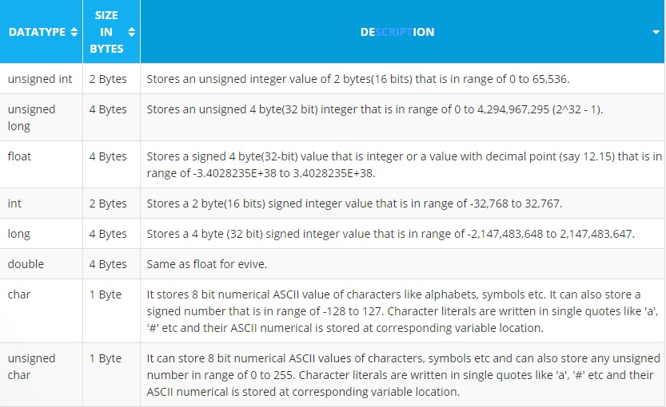
DATA Types

Slide 4
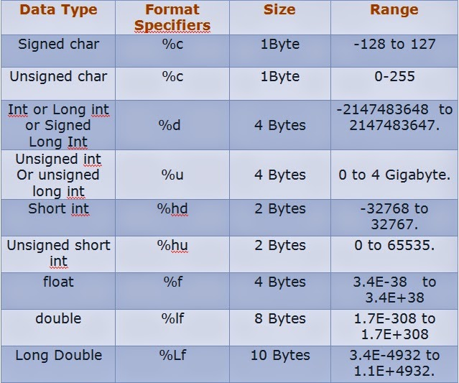
Format specifiers with datatypes

Slide 5
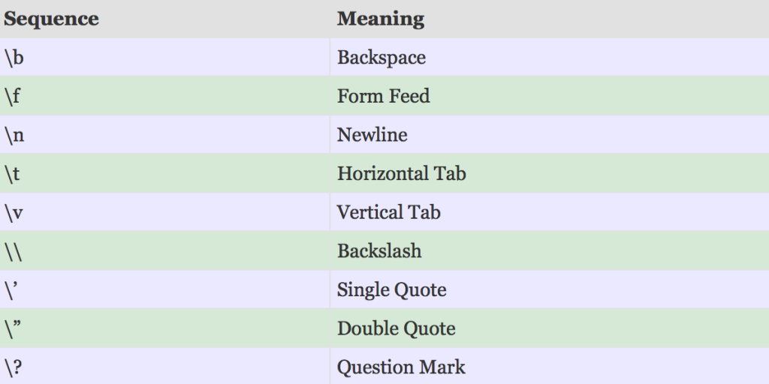
Escape sequences

Slide 6
Variables and Declarations
Variables must be declared before they are used. A declaration consists of the variable type followed by the variable name, and optionally, an initial value. Multiple declarations are allowed. Here are some examples:
int x; This declares a signed 8 bit integer called x
unsigned int y; This declares an unsigned 8 bit integer called y
Int a, b , c; This declares three integers with no initial values stored.
float b =1.0; This declares a real number named b and sets its initial value to 1.0
Note that each of these declarations is followed with a semi-colon. The semi-colon is the C language way of saying “This statement ends here”. This means that you can be a little sloppy (or unique) in your way of dealing with spaces. The following are all equivalent and legal:
float b = 1.0;
float b=1.0;
float b = 1.0 ;

Slide 7
Conditional Statements
C uses a fairly standard if/else construct for basic conditionals. They may be nested and each portion may consist of several statements.
positive or negative logic. The basic construct is:
if( test condition(s).. )
{
…do stuff…
}
The else portion is optional and looks like:
if( test condition(s).. )
{
…do stuff…
}
else
{
…do other stuff…
}

Slide 8
Operators
Relational operators:
== equality
!= inequality
> greater than
< less than
>= greater than or equal to
<= less than or equal to
It is very important to note that equality uses a double equal sign. A single equal sign is an assignment operation. Don’t think “equals”, think “same as”, with one symbol for each word.
Logic operators:
|| OR
&& AND
! NOT

Slide 9
Examples
Time for some examples. The conditional is written as a fragment with an explanation following:
if( a==6 )
/* taken only if the variable a is a 6 */
if( b!=7 )
/* taken as long as the variable b isn’t 7 */
if( (a==6) && (b!=7) )
/* taken as long as a is 6 and b is something other than 7 */
if( (a==6) || (b!=7) )
/* taken as long as a is 6 or b is something other than 7 */
if( a==0 )
/* taken if a is zero */
if( !a )
/* another way of saying taken if a is zero */
if( a!=0 )
/* taken if a is not zero */
if( a )
/* another way of saying taken if a is not zero */

Slide 10
NESTED CONDITIONS
If a multiple condition won’t cut it, you can nest if/else tests. Nesting conditionals is easy:
if( test condition(s).. )
{
if( other tests.. )
{
}
else
{
}
}
else
{
…. Do task ……
}

Slide 11
Switch Case
For selection of a single value out of a list, you can use the switch/case construct. The template looks like:
switch(test_variable)
{
case value_1:
...do stuff...
break;
case value_2:
..do other stuff...
break;
default:
...do stuff for a value not in the list...
break;
}

Slide 12
EXAMPLES
switch( x )
{
case 1:
/* This code performed only if x is 1, then jump to closing brace */
break;
case 2:
/* This code performed only if x is 2, then jump to closing brace */
break;
case 3:
/* This code performed only if x is 3, but continue to next case (no break statement) */
case 4:
case 5:
/* This code performed only if x is 3, 4, or 5, */
break;
default:
/* this code performed only if x is not any of 1,2,3,4, or 5, then jump to closing brace (redundant here) */
break;
}

Slide 13
LOOPS
Loops are used in programming to repeat a block of code until a specific condition is met. There are three loops in C programming:
for loop
while loop
do….while loop

Slide 14
FOR LOOP
Syntax of for loop:
for(initialization; condition; increment/decrement)
{
//code;
}
How For Loop Works :
Step 1: First initialization happens and the counter variable gets initialized. Step 2: In the second step the condition is checked, where the counter variable is tested for the given condition, if the condition returns true then the C statements inside the body of for loop gets executed, if the condition returns false then the for loop gets terminated and the control comes out of the loop. Step 3: After successful execution of statements inside the body of loop, the counter variable is incremented or decremented, depending on the operation (++ or –).

Slide 15
EXAMPLE
int main()
{
int i, j=0;
for ( i = 1; i <=3 ; i++ )
{
j++ ;
}
return 0;
}

Slide 16
WHILE LOOP
While loop execute the code until condition is false.
Syntax of for loop:
while(condition)
{
//code
}
How while loop works?
The while loop evaluates the test expression.
If the test expression is true (nonzero), codes inside the body of while loop is executed. The test expression is evaluated again. The process goes on until the test expression is false.
When the test expression is false, the while loop is terminated.

Slide 17
Example
int main()
{
int count=1;
while (count <= 4)
{
printf("%d ", count);
count++;
}
return 0;
}

Slide 18
Do WHILE LOOP
do…while Loop:
The do..while loop is similar to the while loop with one important difference. The body of do...while loop is executed once, before checking the test expression. Hence, the do...while loop is executed at least once.
Syntax of for loop:
do
{
// codes
}
while (test Expression);
How do...while loop works?
The code block (loop body) inside the braces is executed once.
Then, the test expression is evaluated. If the test expression is true, the loop body is executed again. This process goes on until the test expression is evaluated to 0 (false).
When the test expression is false (nonzero), the do...while loop is terminated.

Slide 19
Example
int main()
{
int x=0, y ;
do
{
y = 0;
}
while(x<=4)
{
y++;
}
}

